Slide 1
Physical and Cultural Characteristics of Kazakhstan

Slide 2
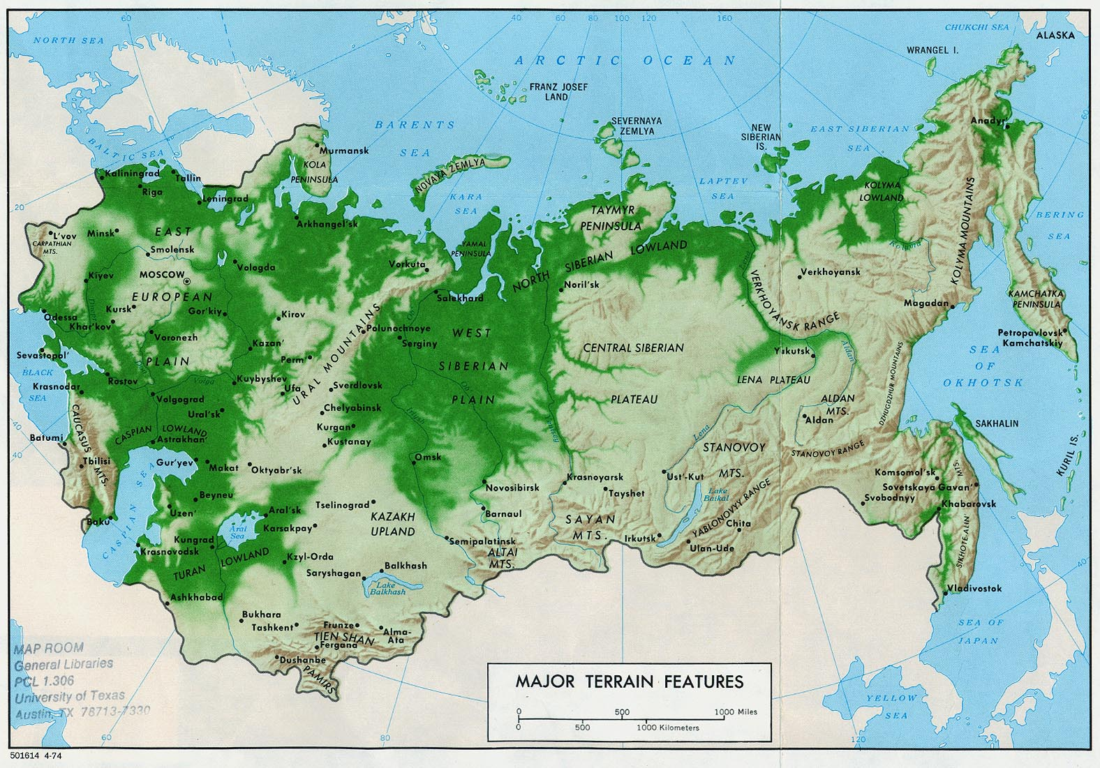
Physical Geography of Central Asia
Notes:
What geographic images do you see on the map?
What water formations are shown?
What land formations are indicated?
How do you think “land” and “landforms” impact the formation of nations?
Image One – Geography of Central Asia
Water formations include:
In the North = Artic Ocean with the Barents Sea, Kara Sea, Laptev Sea, and Eastern Siberian Sea.
In the West = Bering Sea and the Sea of Okhotsk
In the Southwest = Black Sea, Caspian Sea, and the Aral Sea.
In the Northwest = Baltic Sea
Land formations include:
Western Siberian Plan
Central Siberian Plateau
Northern European Plain
Ural Mountains
Turan Lowlands

Slide 3
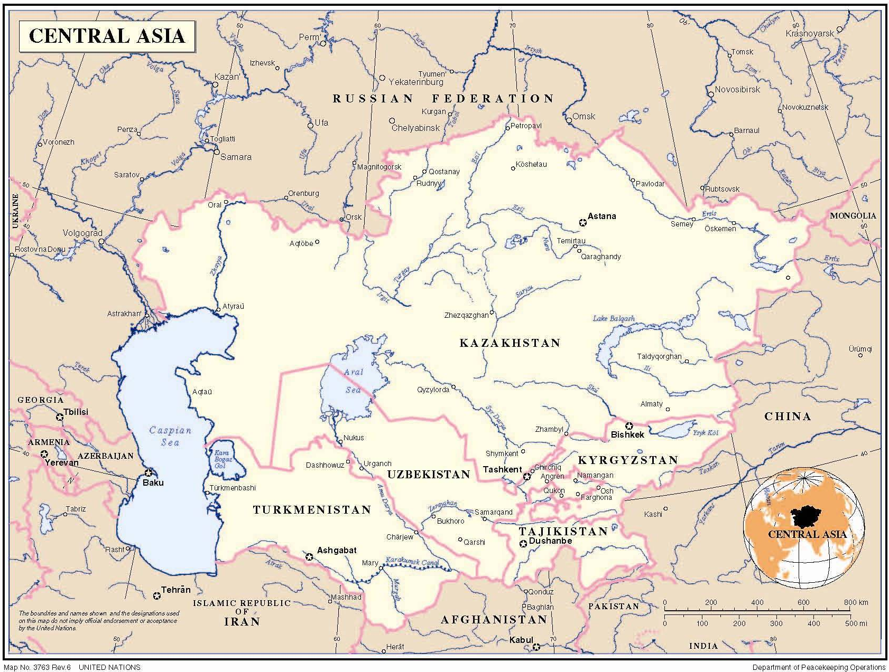
(Political Geography of Central Asia)
Notes:
Have students pair up and discuss possible connections between the geographic features they notice on Map One and the political boundaries that they see on Map Two.
Political Geography of Central Asia
Examples of how physical geography impacts political geography include:
Borders form around bodies of water – e.g. Ural Sea and Caspian Sea
Mountains might prevent people from farming. The inhabitants of this region might be nomadic.
Mountains might also form boundaries when political states are formed.
Fertile land might attract invaders
Cold climates impact culture of populations.
Other rationales might include?

Slide 4
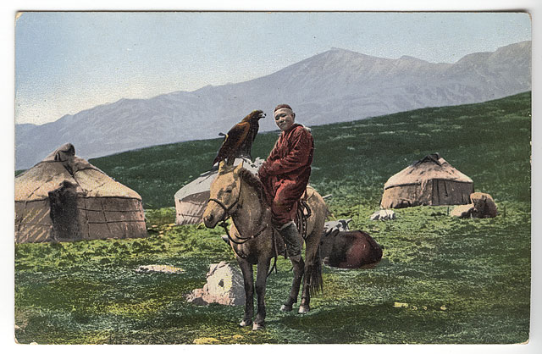
Image #3 (Origins of the Kazakh People)
Notes:
Examples of physical or cultural geography: (p = physical; c = cultural)
Mountains in the background = Ural Mountains (p)
Man wearing layers of clothing = Cold climate (p and c)
Man on horse = nomadic (p and c)
Housing structure is known as a ger = could have to do with nomadic lifestyle or climate (p and c)

Slide 5
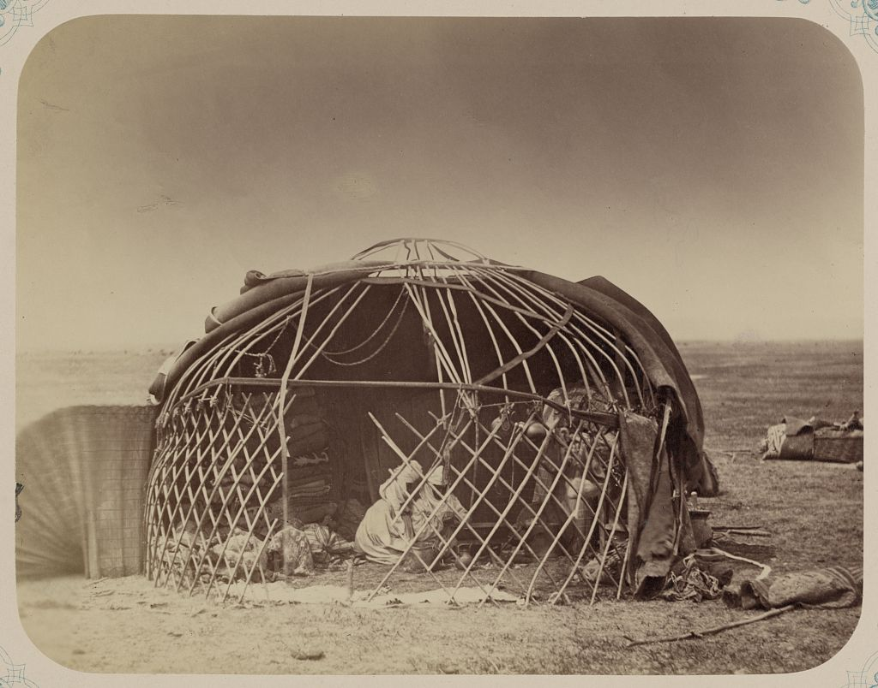
Image #4 (Ger-housing structure)
Notes:
Examples of physical or cultural geography: (p = physical; c = cultural)
Mountains in the background = Ural Mountains (p)
Man wearing layers of clothing = Cold climate (p and c)
Man on horse = nomadic (p and c)
Housing structure is known as a ger = could have to do with nomadic lifestyle or climate (p and c)

Slide 6
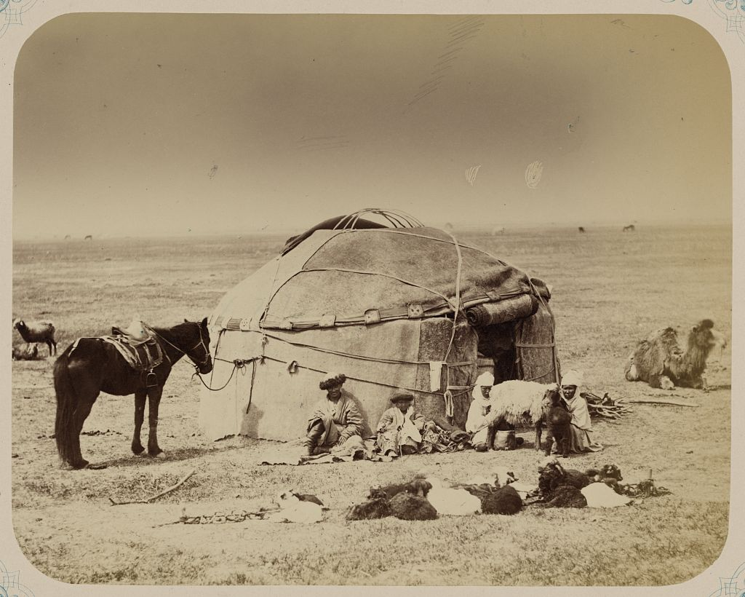
Image #5 (Resting next to the Ger)
Notes:
More human or cultural geographic features are seen in this image:
horses = nomadic (c)
The structures can be taken down and rebuilt = nomadic life style (p and c)

Slide 7
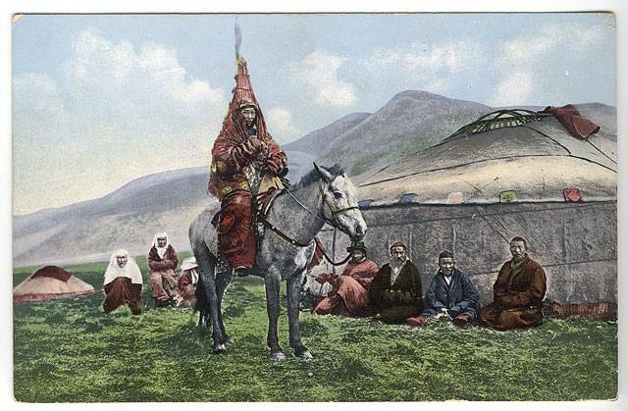
Image #6 (Man on Horse)
Notes:
More information about clothing:
Layers of clothing could protect people from the elements (cold weather, sand storms)

Slide 8
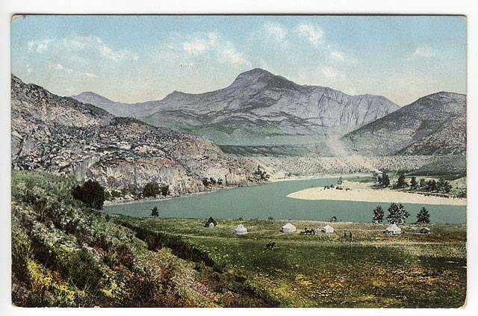
Image #7 (Settlement)
Notes:
Good questions to ask here:
Why do you think the gers are located by water? (water source, maybe protection from the elements; p and c)
What physical feature is located in the background? (Ural mountains; p)

Slide 9
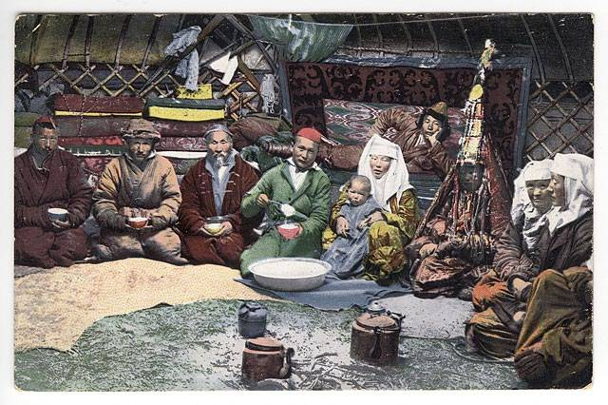
Image #8 (Living Conditions)
Notes:
Good things to point out:
clothing (p and c)
rugs (p and c)
Speculate about the types of food they might eat.

Slide 10
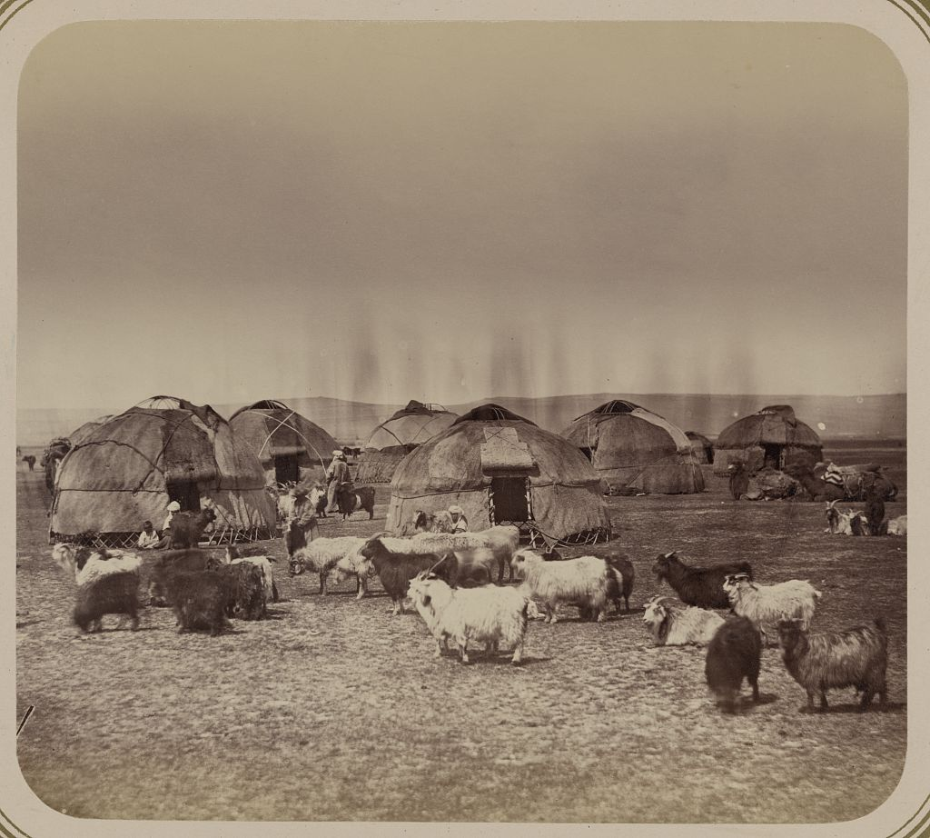
Image #9 (Herding)
Notes:
Key aspect in this image:
lifestyle indicates they are herders
Also the ability to move around along long tracks of land contribute to a nomadic lifestyle (p and c)

