Slide 1
Development
Chapter 9
Willowbrook High School 2011

Slide 2
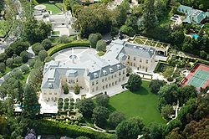

Slide 3
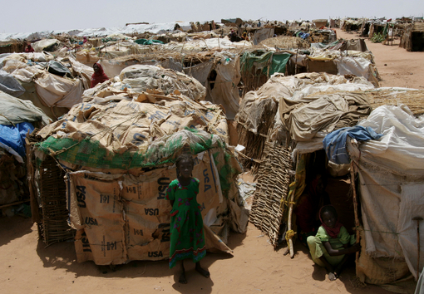

Slide 4
Development
The process of improving the material conditions of people through diffusion of knowledge and technology…
What does that mean?!
Continuous process…every place lies along a continuum.
Divided into MDC’s (developing) and LDC’s (emerging)

Slide 5
Pride vs. Resentment
MDC = More developed = Modern?
LDC = Less Developed = Backward?
(not meant as a compliment)
So how do we determine what is an MDC v. an LDC?

Slide 6
Human Development Index (HDI)
The UN created the HDI based on 3 measures
Economic factors (GDP per capita)
Social factors (literacy rate/education)
Demographic factors (life expectancy)
A single number (Index #) is cimputed
Highest # = 1.0 or 100%

Slide 7
Economic Indicators of development
Gross Domestic Product
Value of total output of goods and services produced in a country.
EX. 2009 GDP US = 14 trillion divided by population of 307 million = GDP per capita of 46,000.

Slide 8
Types of Jobs
Primary
Agriculture/fishing
Directly extract materials from the earth
Secondary
Manufacturing
Transform or assemble materials into useful products
Tertiary
Services
Retailing, banking, law, education, government.

Slide 13
Productivity
Value of a product compared to the amount of labor needed to make it.

Slide 14
Social Measures of Development
Education and Literacy
Higher the education and literacy, the higher the development.
Avg. number of years attended
Student/teacher ratio (over 30:1 in LDC’s)
Literacy rate (over 98% in MDC’s)
Health and Welfare
Ratio of people to hospitals/doctors
Diet. (calories per day)

Slide 15
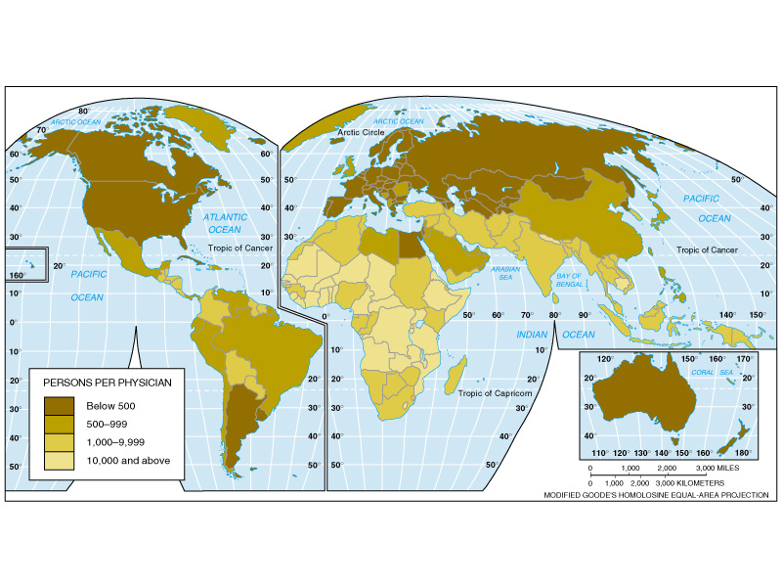

Slide 18
Demographic Indicators
Life expectancy | Number of years a person is expected to live. Based on current death rates. | Positive impacts (increase)
Fertility | Number of live births per female of reproductive age (15-49). Indicates population change over a long period of time. | Positive impacts (lower)
Infant mortality | Numbers of deaths of infants (below 5 years) year per 1000 live births of the same year. Reflects the quality of the health system. | Positive impacts (lower)
Adult literacy | People above 15 years able to read standard instructions. | Positive impacts (increase)
Child labor | Economically active children under the age of 14. Can combine work and education. | Mitigated impacts

Slide 19
Life Expectancy Rate
LDC’s – babies exptected to live to 60
MDC’s – Babies expected to live into their 70’s
MEN – 10 years longer in MDC’s
WOMEN – 13 years longer in MDC’S

Slide 21
Infant Mortality Rate
LDC’s – 94% survive
Die from malnutrition, lack of medicine, poor medical practices
MDC’s – 99.5% survive

Slide 23
Natural Increase Rate (difference between births and deaths.)
LDC’s – 1.5%, MDC’s - .2%
Crude Birth Rate: (# of births per 1,000)
23:1,000 in LDC
12:1,000 in MDC
MCD’s choose not to have children (economic/social)
Birth control
Family planning
Crude Death Rate: (# of death’s per 1,000)
Not a good indicator for development

Slide 24
Computing the HDI
Variables used
ECONOMIC (GDP
SOCIAL (Adult literacy, total school enrollment)
DEMOGRAPHIC (Life expectancy at birth)
Formula
HDI = (1/3 economic)+(1/3 social)+(1/3 demographic)

Slide 25
Where are MDC’s and LDC’s located?
Fill out GO to determine where on the Earth are MDC’s and LDC’s.
Use pages 281-288.

Slide 26
Tomorrow Gender Equality!

