Slide 1
End Poverty and Hunger
By: Tommy K., Trey J.,
and Matthew D.
“Try not to become a man
of success
but a man of value.”
-Albert Einstein

Slide 2
The Problem
Extreme poverty and hunger are affecting people all around the world…

Slide 3
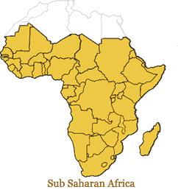
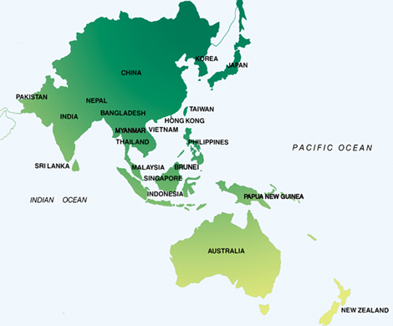
Location
Sub-Saharan Africa
Since Asia has succeeded in reducing their own poverty…this has lowered the poverty of the entire world
Most affected regions are Sub-Saharan Africa and Asia and the Pacific

Slide 4
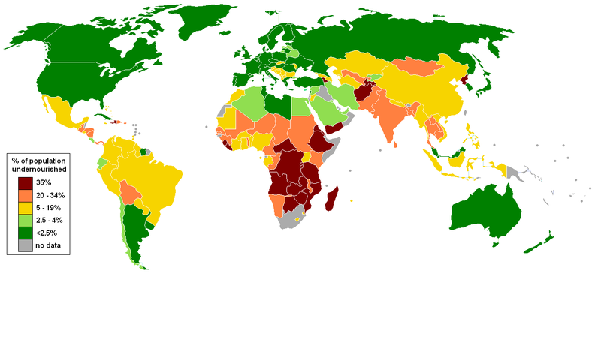
Statistical Data
http://cac-ib-geography.wikispaces.com/Food

Slide 5
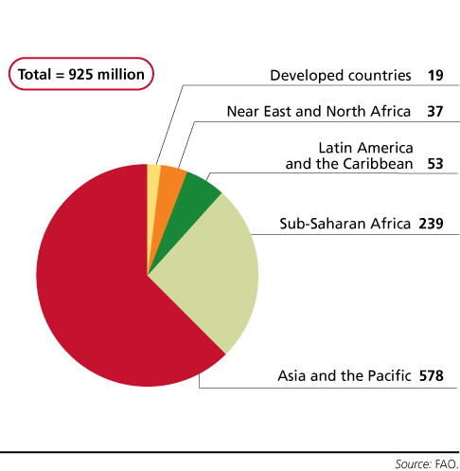
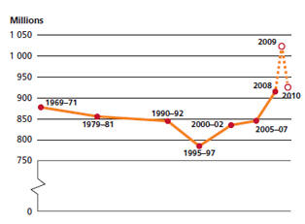
Hunger/Poverty Graphs
925 million people hungry
# of hungry people (1969 – 2010)

Slide 6
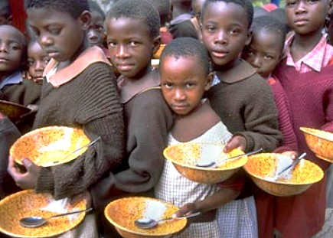
Hunger Statistical Data
98% of world’s undernourished people are in developing countries
Location of worst hunger: Asia and Pacific = 578 million people Sub-Saharan Africa = 239 million people
http://www.shc.edu/theolibrary/graphics/hunger.jpg

Slide 7
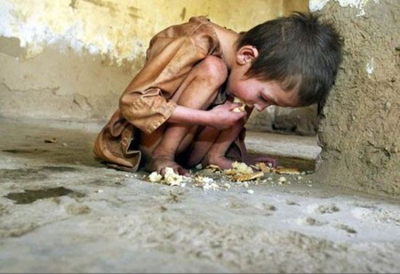
Poverty Statistical Data
1.4 million people in developing countries
live on $1.25 or less a day
22,000 children die every day due to poverty conditions
1.7 billion lack access to clean
water
http://www.webdesigncore.com/wp-content/uploads/2010/10/poverty33.jpg

Slide 8
Local and Global Impact
In 2009, 43.6 million people were in poverty in America
In 2007, 12% (1.5 million) of Illinois Residents were living in poverty
Around 846,000 people who are food insecure in Cook Country right now

Slide 9
Our Solution
End Poverty=End Hunger
http://www.bemore.org.au/images/db/bmp/651.jpg

Slide 10
Step by Step Solution
Poverty
MDC’S come in with resources
Filter water so they have clean water and add acces to water
Bring in nutritional needs
Supply cloths and shelter
Setup more education and healthcare

Slide 11
Step by Step Solution
Hunger
End Poverty
Lower cost of food
Help bring in food to help raise supplies
DONT WASTE FOOD!!!

Slide 12
Citations
http://www.globalissues.org/article/8/solving-world-hunger-means-solving-world-poverty
http://en.wikipedia.org/wiki/Poverty
http://www.downtoearth.org/health/general-health/steps-to-end-world-hunger
http://www.worldhunger.org/articles/Learn/world%20hunger%20facts%202002.htm
http://feedingamerica.org/hunger-in-america/hunger-facts/hunger-and-poverty-statistics.aspx
http://www.chicagosfoodbank.org/site/PageServer
http://www.wsws.org/articles/2009/jul2009/chic-j01.shtml
http://www.feedingillinois.org/hunger/

